Slide 1
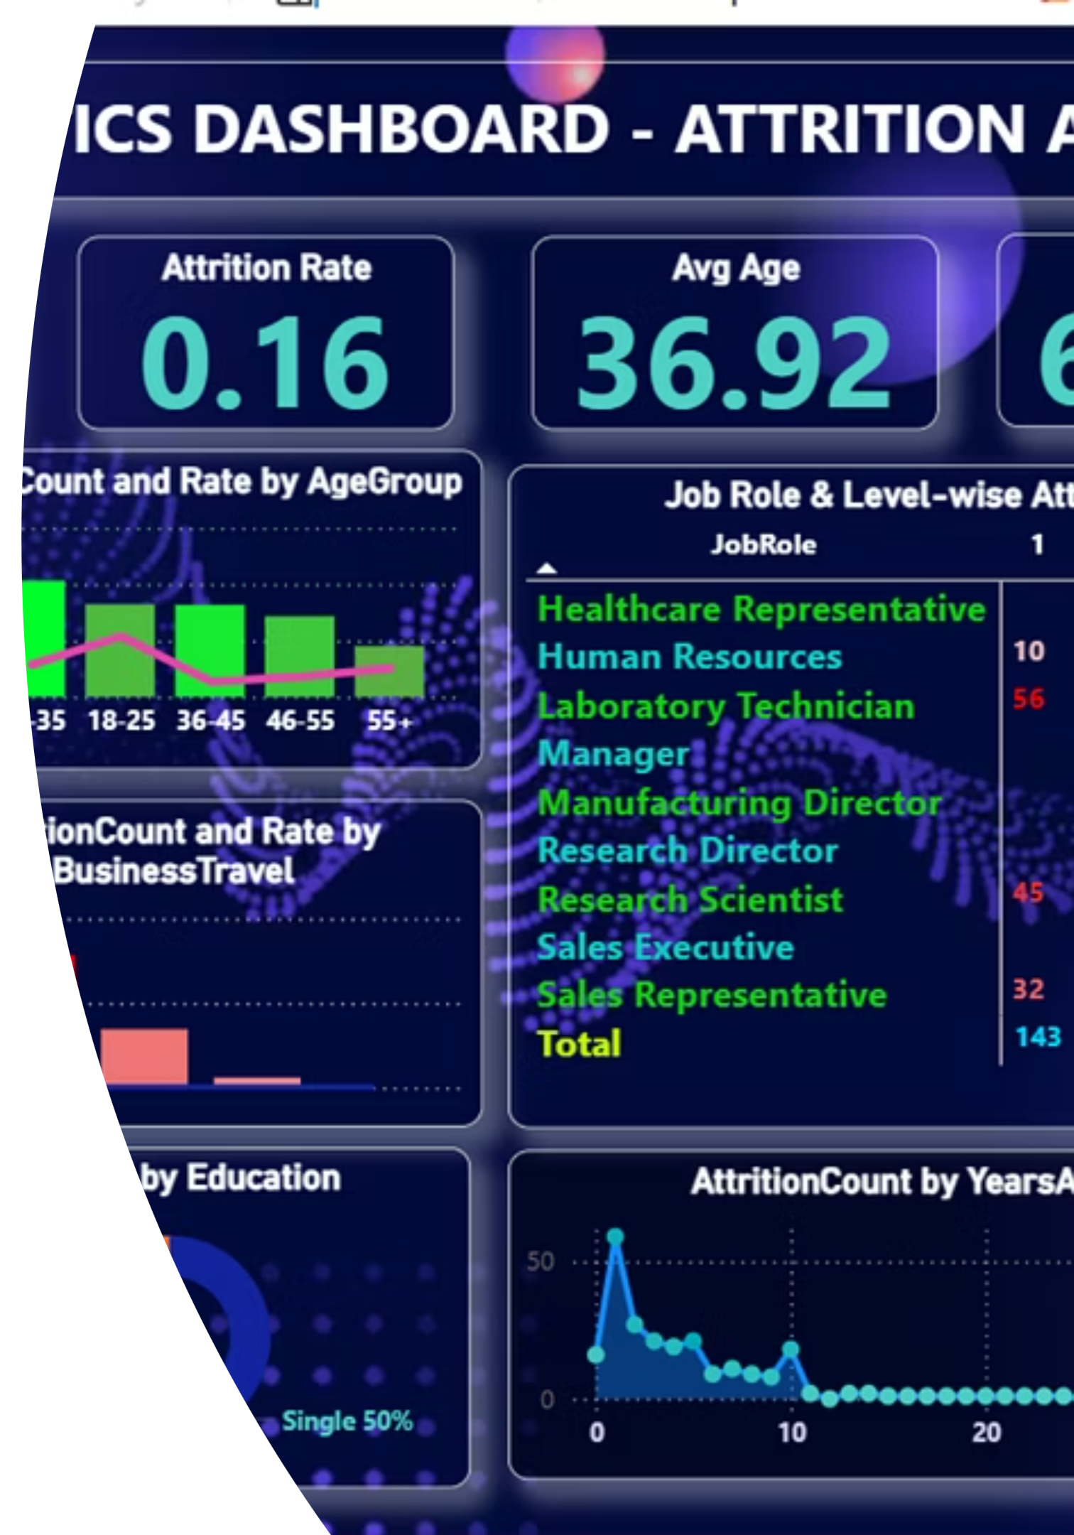
HR Analytics Dashboard – Attrition Analysis
Data-Driven Insights to Reduce Employee Attrition
Prepared by: Srimathi C.M. | Data Analyst | Power BI

Slide 2

Problem Statement
The Challenge We Face
High employee attrition significantly impacts organisational productivity and creates substantial financial burdens through recruitment and training costs.
Without proper analysis, HR teams struggle to identify patterns and implement effective retention strategies. Understanding the root causes of attrition is critical for building a sustainable workforce.

Slide 3


Project Objectives
Analyse Overall Attrition
Identify Key Drivers
Uncover the primary factors and patterns contributing to employee turnover
Examine comprehensive attrition data across the entire organisation to establish baseline metrics
Deliver Actionable Insights
Provide data-backed recommendations to support strategic HR decision-making

Slide 4
Dataset Overview
Comprehensive Employee Data
Demographics
Employment Details
Age distribution
Department assignment
Our analysis leverages a robust dataset of 1,480 employees, capturing critical workforce information across multiple dimensions.
Gender composition
Job role specifics
Education background
Years of tenure
Each employee record includes demographic details, role information, compensation data, and attrition status, enabling thorough pattern analysis.
Compensation
Salary information
Benefits package
Attrition status

Slide 5
Tools & Technologies
Power BI
Excel / CSV
Primary visualisation platform for creating interactive dashboards and real-time analytics
Data source management and preliminary data cleaning operations
DAX
Power Query
Advanced calculations and custom measures for complex analytics
Data transformation and preparation for analysis-ready datasets

Slide 6
Key Performance Indicators
1,480
238
16%
Total Employees
Attrition Count
Attrition Rate
Complete workforce analysed
Employees who left the organisation
Overall turnover percentage
Average Age: 36.92 years
Average Salary: ₹6.5K
Average Tenure: 7.01 years
Workforce demographic profile
Mean monthly compensation
Employee retention duration

Slide 7
Interactive Dashboard Overview
The Power BI dashboard provides real-time attrition insights through dynamic visualisations and interactive filters, enabling HR teams to drill down into specific segments and uncover actionable patterns.
Department Filters
Time-Based Analysis
Custom Segments
View attrition by Sales, Research, or HR departments
Track trends across different tenure periods
Analyse by salary, age groups, or job roles

Slide 8





Critical Insights: Attrition Patterns
Salary Impact
Lower salary brackets show significantly higher attrition rates, indicating compensation is a primary retention factor
Department Trends
Sales and Research departments experience elevated turnover compared to other organisational units
Tenure Vulnerability
Employees in their first 2-3 years demonstrate the highest attrition risk, highlighting onboarding importance
Travel Factor
Frequent business travel correlates strongly with increased attrition probability

Slide 9

Strategic Impact & Next Steps
Business Impact
Future Enhancements
Enhanced retention strategies
Predictive attrition modelling
Reduced hiring costs
SQL database integration
Improved workforce planning
Machine learning algorithms
Data-driven HR decisions
Real-time alert systems
Thank You
For more insights and collaboration opportunities, please connect with me on LinkedIn or via email.
Srimathi C.M. | Data Analyst | HR Analytics Specialist

